Slide 1
Smart Grid Stability using Deep Learning
By
Ratnadeep Das Choudhury (19BEE1125)
Souvik Datta (19BEE1213)

Slide 2
Artificial Neural Network (ANN)
The artificial neural network (ANN) architecture depicted below is the optimal one evaluated for this project. It reflects an Sequential structure with:
One input layer (12 input nodes)
Three hidden layers (24, 24 and 12 nodes, respectively)
One single-node output layer.

Slide 3
Artificial Neural Network (ANN)
Since we have features that are numerical real numbers within a range, the choice of 'relu' as the activation function for hidden layers seems straightforward.
Similarly, as this is a logistic classification problem, where the output is binary ('0' for 'unstable', '1' for 'stable') the choice of 'sigmoid' as activation for the output layers seemed appropriate.
Compilation with 'adam' as optimizer and 'binary_crossentropy' as the loss function follow the same logic. The fitting performance will be assessed using 'accuracy' as the metric of choice.

Slide 4
Layers of ANN - Code
classifier = Sequential()
# Input layer and first hidden layer
classifier.add(Dense(units = 24, kernel_initializer = 'uniform', activation = 'relu', input_dim = 12))
# Second hidden layer
classifier.add(Dense(units = 24, kernel_initializer = 'uniform', activation = 'relu'))
# Third hidden layer
classifier.add(Dense(units = 12, kernel_initializer = 'uniform', activation = 'relu'))
# Single-node output layer
classifier.add(Dense(units = 1, kernel_initializer = 'uniform', activation = 'sigmoid'))
# ANN compilation
classifier.compile(optimizer = 'adam', loss = 'binary_crossentropy', metrics = ['accuracy'])

Slide 5
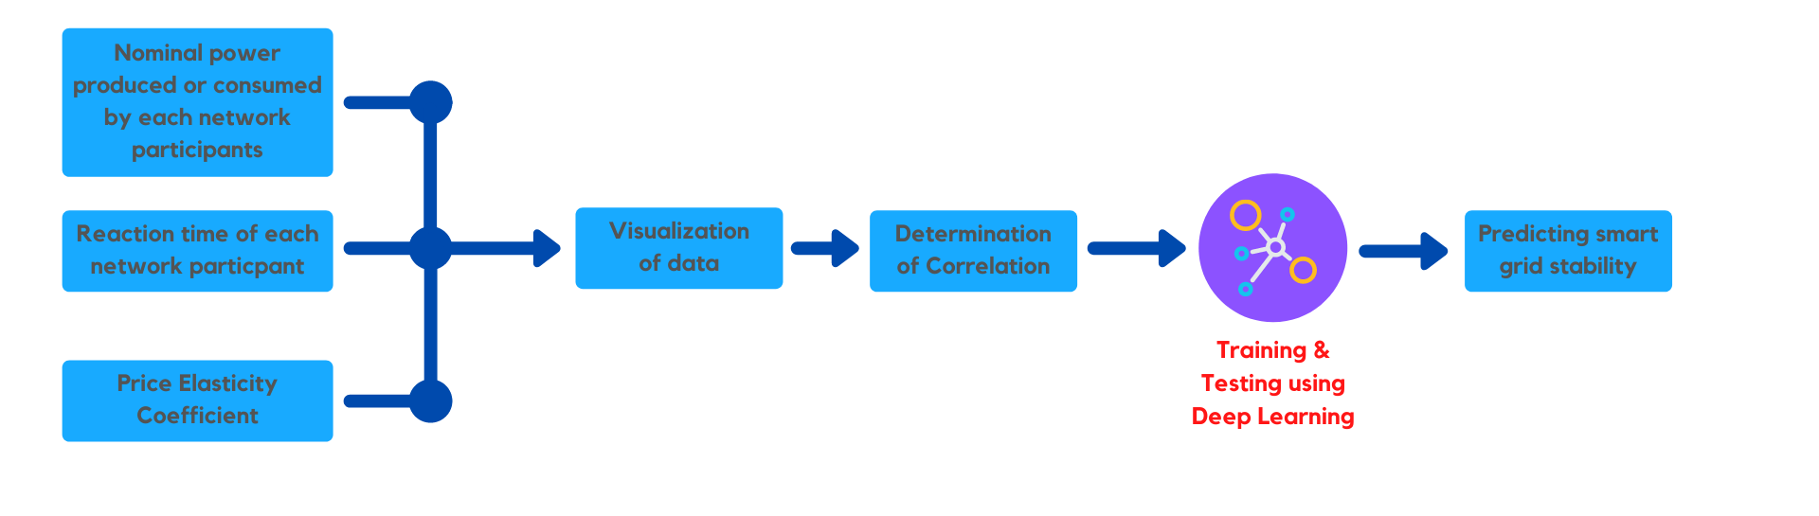
Block Diagram

Slide 6
Smart Grid Stability
In a smart grid, consumer demand information is collected, centrally evaluated against current supply conditions and the resulting proposed price information is sent back to customers for them to decide about usage. As the whole process is time-dependent, dynamically estimating grid stability becomes not only a concern but a major requirement.
The objective is to understand and plan for both energy production and/or consumption disturbances and fluctuations introduced by system participants in a dynamic way, taking into consideration not only technical aspects but also how participants respond to changes in the associated economic aspects (energy price).

Slide 7
Decentral Smart Grid Control (DSGC)
Decentral smart grid control is a methodology strictly tied to monitoring one particular property of the grid - its frequency. The term 'frequency' refers to the alternate current (AC) frequency, measured in cycles per second or its equivalent unit, Hertz (Hz). Around the world AC frequencies of either 50 or 60 Hz are utilized in electric power generation-distribution systems.
The frequency increases in times of excess generation, while it decreases in times of underproduction. Therefore, measuring the grid frequency at the premise of each customer would suffice to provide the network administrator with all required information about the current network power balance, so that it can price its energy offering - and inform consumers - accordingly.

Slide 8
DSGC Implementation
The DSGC differential equation-based mathematical model aims at identifying grid instability for a reference 4-node star architecture, comprising one power source (a centralized generation node) supplying energy to three consumption nodes. The model takes into consideration inputs (features) related to:
the total power balance (nominal power produced or consumed at each grid node);
the response time of participants to adjust consumption and/or production in response to price changes (referred to as "reaction time);
energy price elasticity.

Slide 9
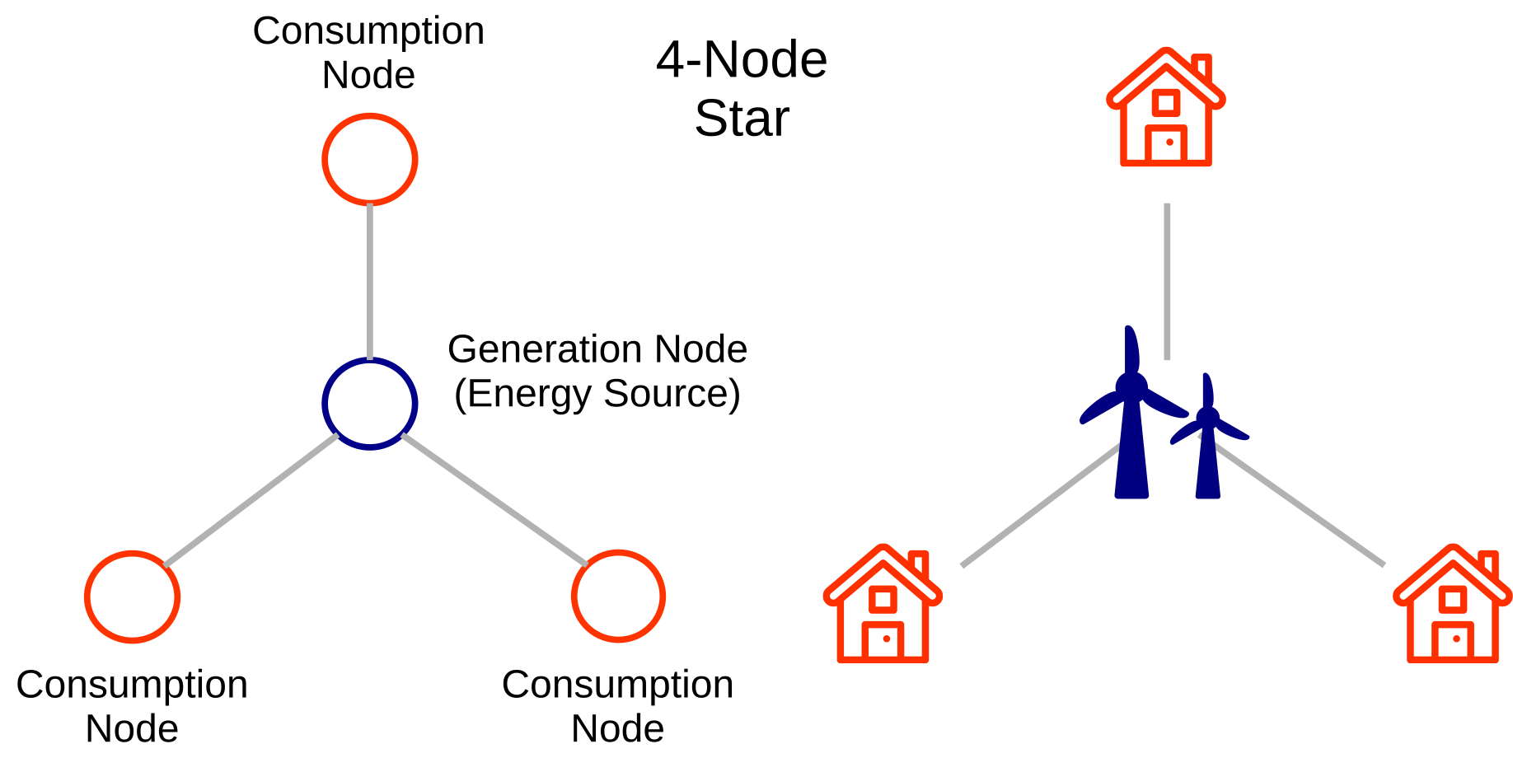

Slide 10
References
Breviglieri, P., Erdem, T., & Eken, S. (2021). Predicting Smart Grid Stability with Optimized Deep Models. SN Computer Science, 2(2). doi:10.1007/s42979-021-00463-5
Azad, S., Sabrina, F., & Wasimi, S. (2019, November). Transformation of smart grid using machine learning. In 2019 29th Australasian Universities Power Engineering Conference (AUPEC) (pp. 1-6). IEEE.
Omitaomu, O. A., & Niu, H. (2021). Artificial intelligence techniques in smart grid: A survey. Smart Cities, 4(2), 548-568.

